Slide 1
Bus Priority: Best Practice
A summary of bus priority initiatives in the UK and internationally

Slide 2
Contents
Bus priority measures 3
Partnership approaches 9
Further information 15

Slide 3
Bus priority measures
Measures to improve bus services and increase patronage, by cutting through congestion

Slide 4
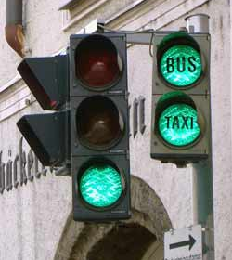
Priority Signalling
Definition:
Bus priority signalling – bus communicates with traffic light, so it stays green for longer to let the bus through quicker. Some technology also senses when a bus is running late, to give it additional priority.
Examples:
Aberdeen; Ellon Road/Beach Boulevard
Swansea
Liverpool City Region Bus Alliance
West Midlands Bus Alliance
West of England Bus Partnership
South East Dorset
Seattle King County, USA
Benefits:
Faster bus journey times: up to 31 seconds per junction (Transport for Greater Manchester, 2019)
Increased bus patronage and reduced congestion

Slide 5
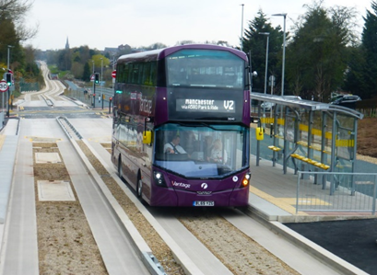
Guided Busway
Definition:
A dedicated, buses-only route with buses running on a purpose-built track. The bus is guided along the route so that steering is automatically controlled and follows a set path. The bus driver controls the speed of the vehicle.
Examples:
Leigh Guided Busway – Leigh to Salford to Manchester
Cambridge – 16 miles: longest guided busway in the world
Luton – Houghton Regis to Dunstable to Luton
Bristol – runs from park & ride for 3km
London – proposed guided busway from Brent Cross
to Marylebone station
Kent Fastrack
Benefits:
Unlike normal priority lanes, other road users cannot illegally drive or park on the guided busway, because it is kerbed
Can be built in areas too narrow for standard bus lanes
Standard buses can be easily and cheaply modified for the busway
Buses can go faster and journey is smoother

Slide 6
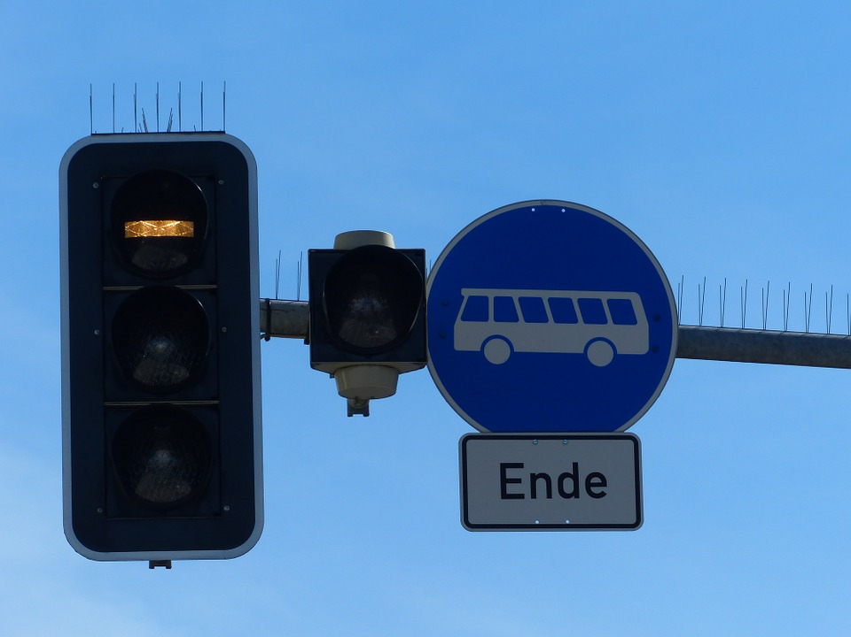
Bus Advance Area
Definition:
A facility which enables buses to get to the head of a traffic queue at a signalised junction; often located at the exit of a bus lane. To date there are few examples but emerging evidence that advance areas can be successful, if the location is carefully chosen.
Examples:
Walworth Road, London
Shepherd’s Bush Green, London
Trialed in Doncaster
Benefits:
Faster journey times
Easier and safer access from bus lane
More reliable timetabling

Slide 7
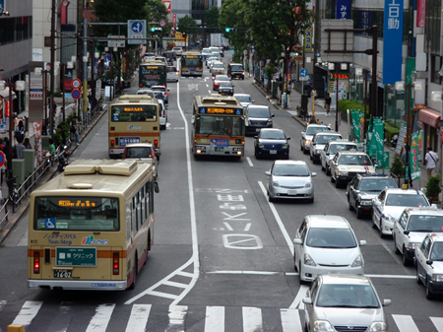
Bus Lanes and Gates
Definition:
Bus lanes are lanes normally reserved for buses only but may also allow access to taxis and cycles. They may be operational all the time or just during peak hours and compliance can be enforced through the use of cameras and penalties. A bus gate is a short piece of road which can only be accessed by bus and may be used in conjunction with bus lanes.
Examples:
Glasgow Fastlink bus lanes, leading to bus gate near Central Station
Edinburgh Calder Road bus lanes
Bus lanes with priority signals from Ferrytoll Park & Ride leading onto the Forth Road Bridge, which is mainly dedicated to bus and active travel
Benefits:
Can be specifically targeted at areas of congestion
Bus gates are relatively cheap to implement
Buses can go faster and journey is smoother
Reduced emissions from idling buses

Slide 8
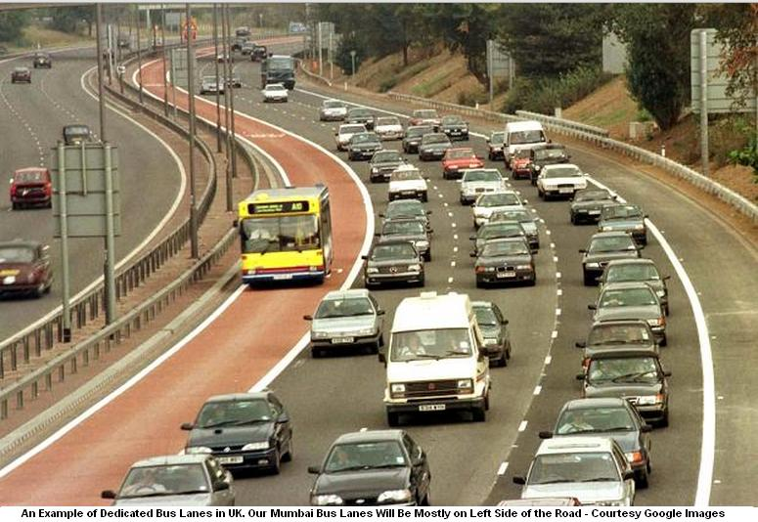
Bus Corridors
Definition:
An extended stretch of road, on which a number of measures are brought together to facilitate bus travel. Typically this will include bus lanes and bus priority measures, as well as an enhanced service provision and improvements to bus passenger infrastructure, such as shelters and information.
Examples:
Glasgow Fastlink
Leeds to Wakefield
West Midlands Coventry Road
Leicester A426
Benefits:
Prevents short areas of bus lane resulting in
hold-ups further down the route
Increases bus patronage, by reducing journey times

Slide 9
Partnership approaches
Examples from the UK and internationally

Slide 10
Integrated, partnership-based approaches: Scotland
Partnership | Partners | Bus service improvement measures | Benefits & future developments
North East Scotland Bus Alliance | Nestrans, Aberdeen City Council, Aberdeenshire Council, First Aberdeen, Stagecoach, Bains Coaches | Bus Alliance Quality Partnership Agreement signed in August 2018 Priority corridors Improved accessibility of buses, shelters, bus stops Interachange with other transport Further development of the GrassHOPPER ticketing product, smart and contactless capabilities, including capping and mobile technology Improved, real-time information Park & ride promotional campaign | Region-Wide Bus Action Plan, targeting the following benefits: Increased proportion of people travelling by bus Improved performance of bus services Improved customer satisfaction Reduce emissions, contributing to improved local air quality and reduced carbon emissions Improved access for all
East Lothian by Bus (campaign and informal partnership) | East Lothian Council, Borders Buses, Lothian Buses, Eve, Prentice of Haddington, Rural East Lothian Bus Users, Bus Users UK | Bus Passenger Charter Integrated working and timetabling Wi-Fi on buses One Ticket: single season ticket across bus operators and rail Joined-up marketing campaign | Increased patronage Reduced cars on roads Reduced fares

Slide 11
Integrated, partnership-based approaches: other UK
Partnership | Partners | Bus service improvement measures | Benefits & future developments
Liverpool City Region Bus Alliance | Liverpool City Region, Mersey Travel, Arriva, Stagecoach | Free-to-use Wi-Fi and USB charging points Investment in traffic signals, bus stops & junctions 70% fleet Lower emission buses Smarter ticketing & simpler fare structure Scrapping of zonal fares Better deal for yong people Operator flat fare structures introduced | Patronage up by 16% and congestion tackled 142% growth in young people’s journeys Bus satisfaction levels up to 91% Improvements so far seen as insufficient by Mayor and Council. Looking at franchising, to further improve the bus offer and reduce congestion
Greater Manchester Bus Consortium "OneBus" | All 18 commercial operators and all ten borough councils | 450 new low-emission buses Simplified and flexible tickets Action plan to tackle congestion and hotspots Single unified branding Improved integration on bus, tram and train WIFI and bus upgrades Co-ordinated approach to traffic management and customer service Collaborative reviews of off-peak services | If pursued, the franchise currently under consideration will supersede the One Bus partnership Cost of moving to franchise around £134m over 5 years
Tyne & Wear - East Gateshead Bus Alliance | Gateshead Council, Go Ahead North East Ltd, Nexus | All buses low emission, none older than 15 years Complimentary wifi Better communication (real time data) to passengers and audio visual equipment Single, unified branding Enforced bus lanes | Progress is being monitored carefully and the best ideas will be used to improve services in other parts of Gateshead and the wider area

Slide 12
Integrated, partnership-based approaches: other UK
Partnership | Partners | Bus service improvement measures | Benefits & future developments
West Yorkshire Bus Alliance | West Yorkshire Combined Authority: 5 local authorities First Bus, Arriva Transdev, Association of Bus Operators in West Yorkshire | Ultra-low-emission buses, with wi-fi Smartcard & better fare deals Compensation for poor journeys & free taxi if last bus is late Improved travel advice Highways improvements Park and ride, with bus priority | West Yorkshire Bus Strategy 2040 seeks to grow bus patronage by 25% by 2027
West Midlands Bus Alliance | National Express, Stagecoach, Central Buses, Claribels, Diamond, iGo, West Midlands Combined Authority (7 local authorities), Local Enterprise Partnerships, Safer Travel Partnership, Transport Focus | Bus enforcement cameras for bus lanes Traffic signal updates, with bus priority detectors Worked with scheme developers and highway authorites in designing networks Low emission new buses and bus station upgrade Discounted fares for young people and NHS staff on specific routes Contactless payment and apps for ticketing and information Free travel for police (who will assist with zero-tolerance rules) | Aim to increase patronage by 5% Passenger numbers increased by 8 million (from 259.3 million to 267.1 million) between March 2018 and March 2019 Up to 8 minutes saved on peak-timebus journeys
Sheffield Bus Partnership (Buses for Sheffield) | Sheffield City Region Combined Authority - including 9 councils, First, Stagecoach, TM Travel, Sheffield Community Transport | Revised bus network £40m joint operator investment in 194 new buses £18m investment in bus infrastructure to improve journey times Integrated smartcard ticketing, contactless payments and online payment Cheapest multi-operator bus prices in the country. | An increase of a million customer journeys Customer satisfaction up to 87%

Slide 13
Integrated, partnership-based approaches: other UK
Partnership | Partners | Bus service improvement measures | Benefits & future developments
Brighton and Hove Bus Partnership | Brighton and Hove Council Brighton & Hove Bus and Coach Company; Stagecoach; The Big Lemon; Metrobus; Compass Travel; the Sussex Bus Co; Brighton & Hove Community Transport; Cuckmere Community Bus | Bus priority routes – up to 20km bus lanes in the city Smart and multi-operator ticketing Bus-based Low Emission Zone in City Centre New routes to reach the Downs Improved passenger waiting areas Real-time information displays and Intelligent Transport System Bus Lane and traffic regulation enforcement Improved service frequencies Value for money fares and tickets Investment in new buses | 14% of residents commute by bus Bus patronage increase of 8.3% between 2011 and 2017 Number of passengers on main bus lane route up by 63% 16% increase in journey times – 7 mins faster than in 1966 High levels of bus satisfaction: 92% Operators have been able to invest Looking at franchising
West of England Partnership | West of England Combined Authority (3 councils), North Somerset Council, Department for Transport, First West of England | Bus priority measures (new bus lanes and intelligent traffic signals) New cleaner, greener and more accessible buses Real-time information Improved links to other transport New shelters, with better information and comfort | Increasing bus use in Bristol, with 54% passenger growth between 2012/13 and 2018/19 Looking at further partnership agreement and franchising options
South East Dorset (Bournemouth and Poole) | Bournemouth Borough Council, Borough of Poole , Dorset County Council, Transdev Yellow Buses, Go South Coast | Bus lanes Greener, more comfortable buses with wi-fi Bus activated traffic signals Real-time information & reliable timetables Refurbished bus station, bus shelter improvements and lowered pavements Worrking to put bus at the heart of planning for schools, hospitals, housing, town centres and social services. | 5.4 million more bus journeys in 2017-18, compared to the previous year Bournemouth among the top 10 areas in England for highest bus use

Slide 14
Integrated, partnership-based approaches: other UK
Partnership | Partners | Bus service improvement measures | Benefits & future developments
Belfast Glider | Translink (3 bus operators), Department for Infrastructure; Ardmore (comms partner) | A bus rapid transit system, using modern, articulated, tram-style buses Uses new and existing bus lanes Traffic light prioritisation Increased distance between bus stops – 400m Integration with other modes and cycle parking at key hubs | Since Sept 2018, has increased bus patronage by 30% 25% reduction in journey times and increased reliability Cost to date £90m but further corridor in development

Slide 15
Integrated, partnership-based approaches: international
Project | Partners | Bus service improvement measures | Benefits & future developments
Bx41 Select Bus Service on Webster Avenue, NYC | New York City Transit, the City's Department for Transportation | A Select Bus Service - limited stops Off-board tickets at most stops Dedicated bus lanes Loading zones, parking restrictions, and cross-traffic turn bans | 19-23% increase in commercial speed Increased patronage Little adverse effect on existing traffic
Quality Bus Corridor (QBC), Stillorgan Road, Dublin | Dublin Buses, the Irish National Transport Authority | Dedicated bus corridor (one of 16 proposed and currently being developed) Traffic signal priority | Peak-hour bus speeds 30% faster than car speeds 176% increase in bus patronage and corresponding 43% reduction in car use between 1997 and 2007

Slide 16
Additional information

Slide 17
Further reading
Title | Author | Date | Synopsis | Link
The identification and management of bus priority schemes | Imperial College, London - Railway and Transport Strategy Centre | Apr-17 | Analysis of bus priority schemes in 14 cities across the world. Includes factors affecting success or failure and methods of selecting priority schemes. | https://www.imperial.ac.uk/media/imperial-college/research-centres-and-groups/centre-for-transport-studies/rtsc/The-Identification-and-Management-of-Bus-Priority-Schemes---RTSC-April-2017_ISBN-978-1-5262-0693-0.pdf
What's driving bus patronage change? | Urban Transport Group | Jan-19 | Evidence on what affects bus patronage, including the impact of priority measures | http://www.urbantransportgroup.org/system/files/general-docs/Urban%20Transport%20Group%20-%20What%27s%20driving%20bus%20patronage%20change%20FINAL_0.pdf
Bus Connects | National Transport Authority, Dublin |  | Website detailing a range of measures being developed and implemented in Dublin, as part of a 10-year programme to provide a more reliable bus service | https://busconnects.ie/
Buses with High Levels of Service (BHLS) | COST – European Cooperation in Science & Technology | Oct-11 | Case studies of BHLS projects around Europe, showcasing holistic approaches to infrastructure and operations | https://www.uitp.org/sites/default/files/cck-focus-papers-files/BHLS_COST_final_report_October2011.pdf

Slide 18
Email: buspartnershipfund@transport.gov.scot

